Slide 1
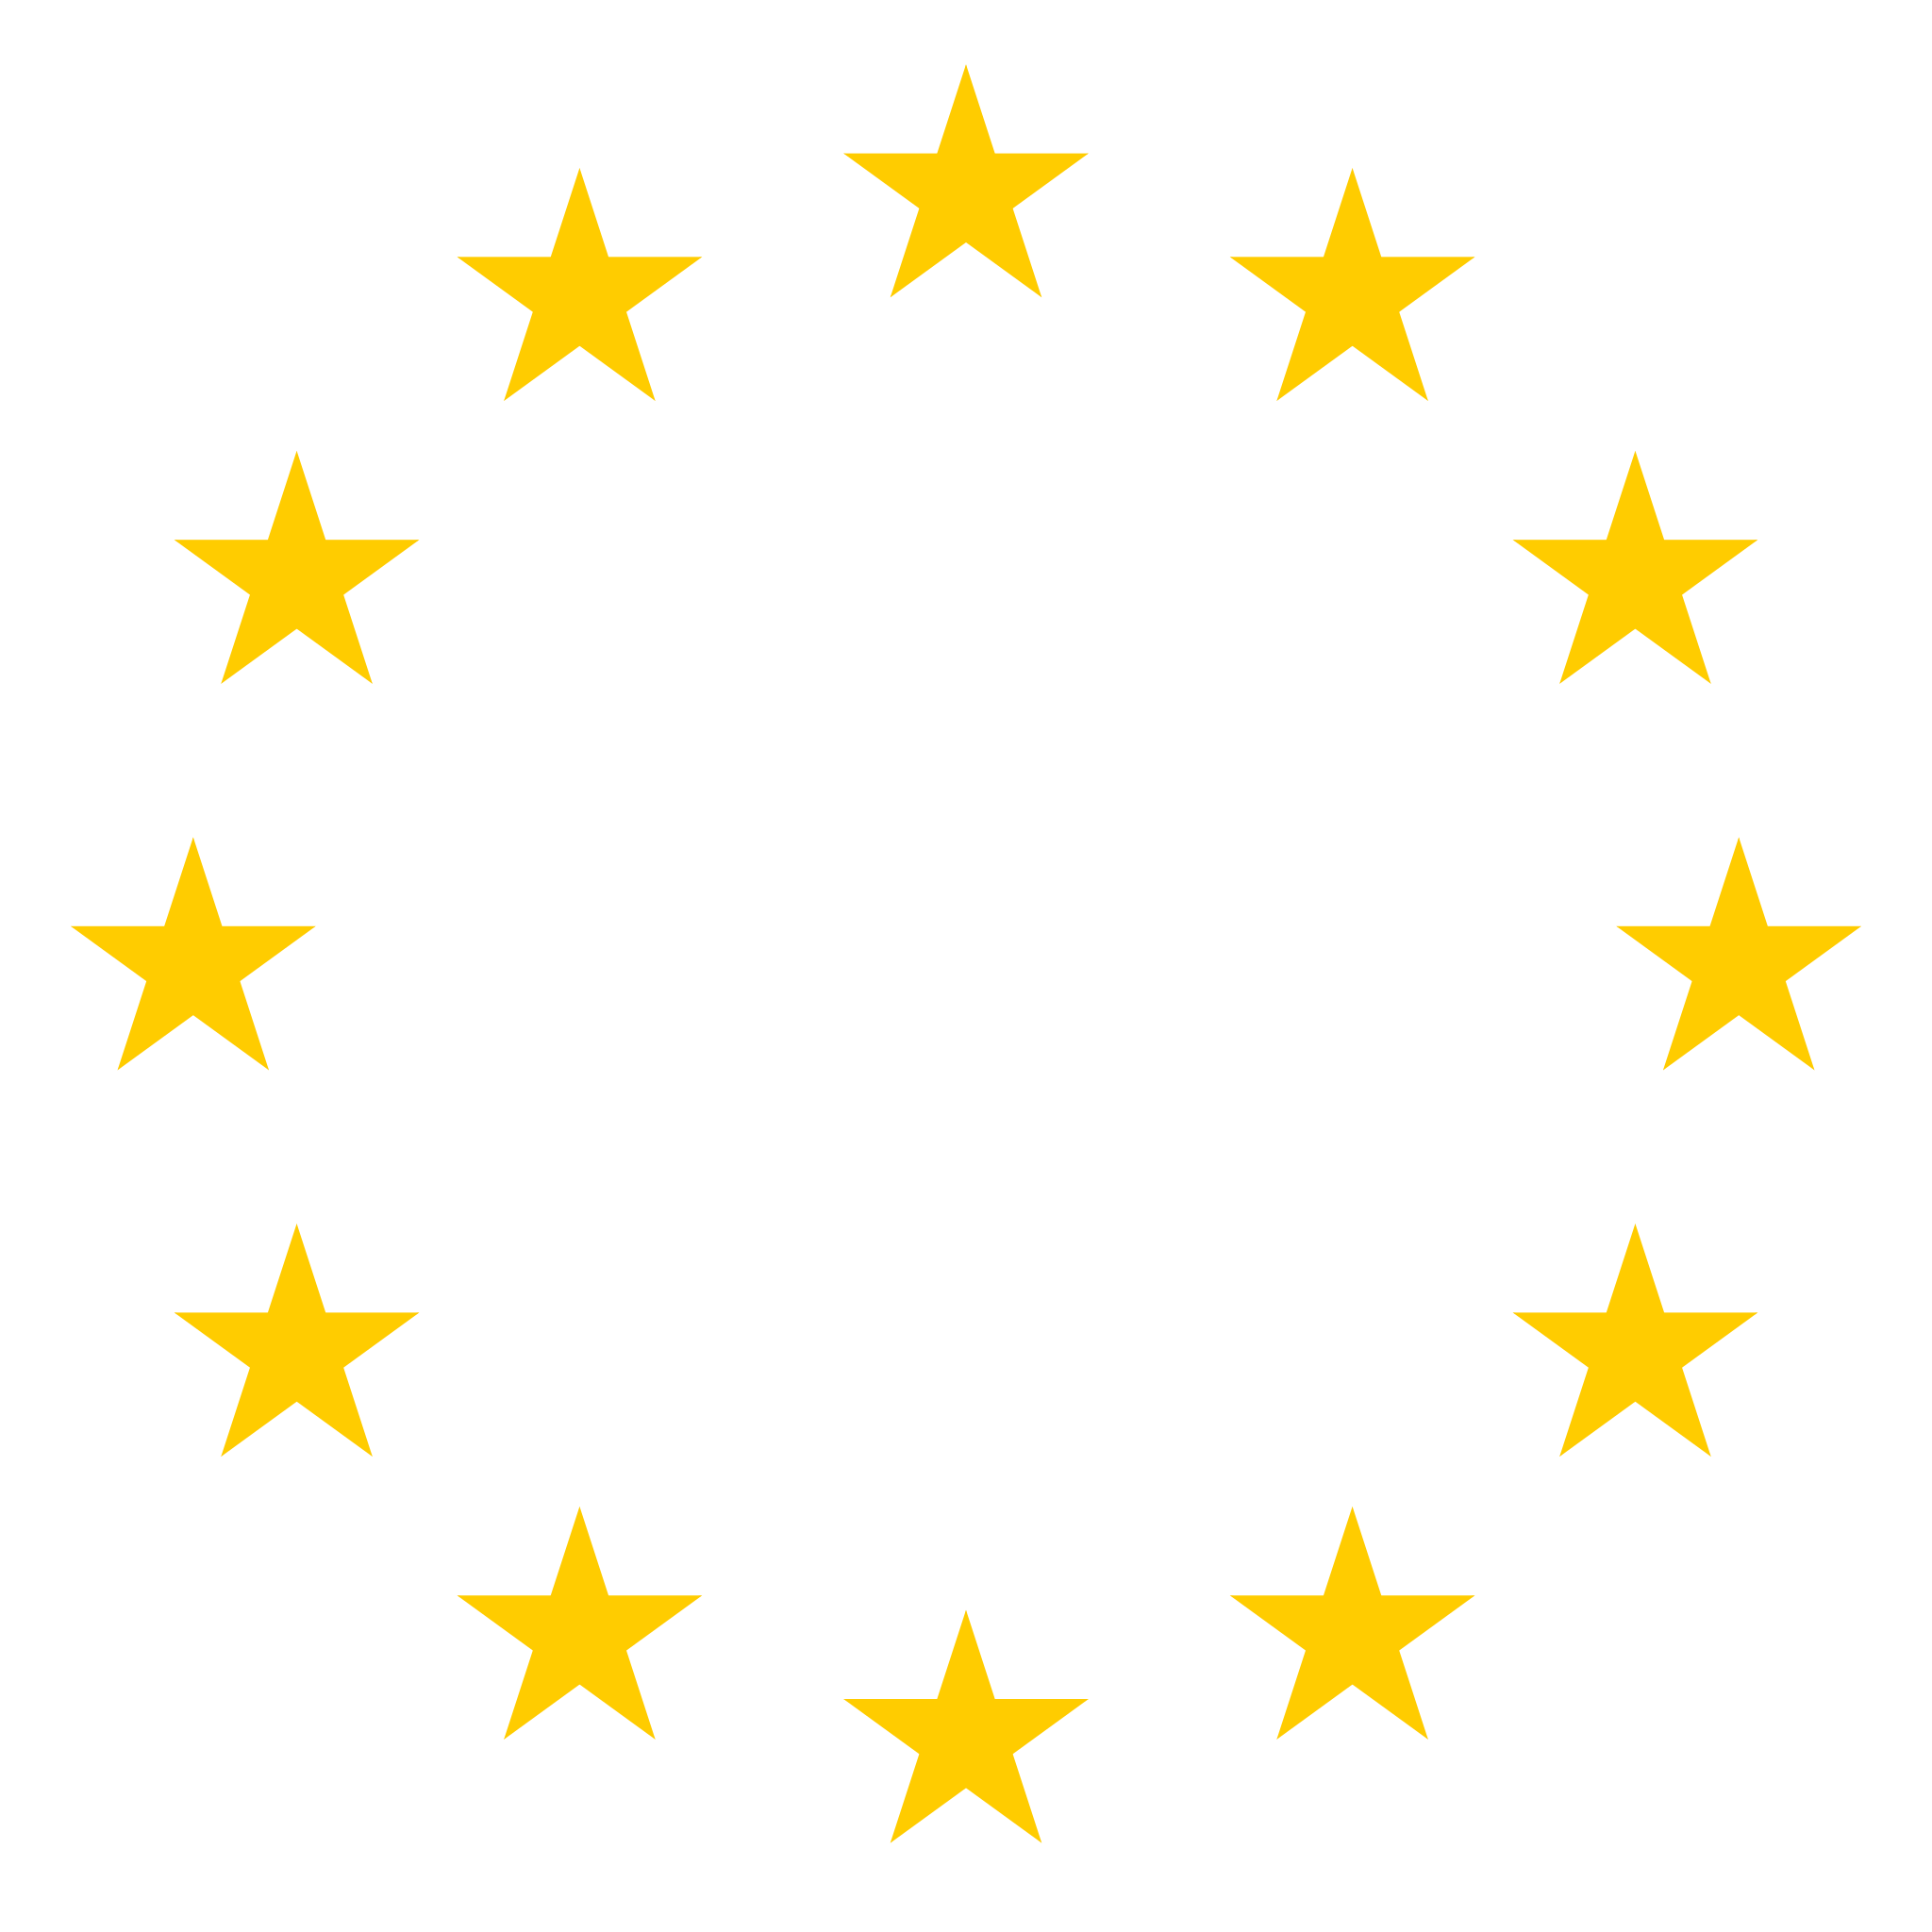
EUgene
WE READ THE RULES. YOU SHIP THE PRODUCT.

Slide 2
But what’s holding Europe back ?
Notes:
Europe has over 100 million more people than the United States, yet when you look at the technologies people in the US rely on every single day almost none of them were built in Europe.
But whats holding europe back?
We can dig a little deeper. Let's start with the borders. The European Union is a political and economic union, yes, but it's not a single market the same way the US is.

Slide 3

“ The broader challenge is that Europe,
despite its economic size, still operates
as a collection of individual countries
rather than as a unified market in the
way the U.S. does.
This makes it harder to build
companies at scale ”
- Daniel Ahremark, CFO of Mews -
Notes:
According to Daniel Armar, CFO at
Dutch Hospitality Software Unicorn, Mews, the broader challenge is that Europe, despite its economic size, still operates as a collection of individual countries rather than a unified market in the same way the US does. This makes it harder to build companies at scale. End quote.

Slide 4
27 Regulatory Systems .
24 Languages .
Patchwork of tax, labor and data laws .
Notes:
Every startup in Europe has
to deal with 27 different regulatory
systems, 24 official languages, and a
patchwork of tax, labor, and data
laws.

Slide 5
“ America innovates, EU regulates. ”
Notes:
There's a saying that's going
around online, America innovates and the EU regulates. While this is true at a glance, regulation isn't inherently bad.
However, there's a massive
problem with the European setup. The very same regulations that protect consumers also impose massive compliance costs that smaller startups can't afford.
You could argue that these rules
protect society, but at the same time,
they've also unintentionally raised the bar for entry.
We believe that this is a problem worth solving. And I’d say Let’s jump into a showcase of our solution EUgene with a Live Demo.

Slide 6
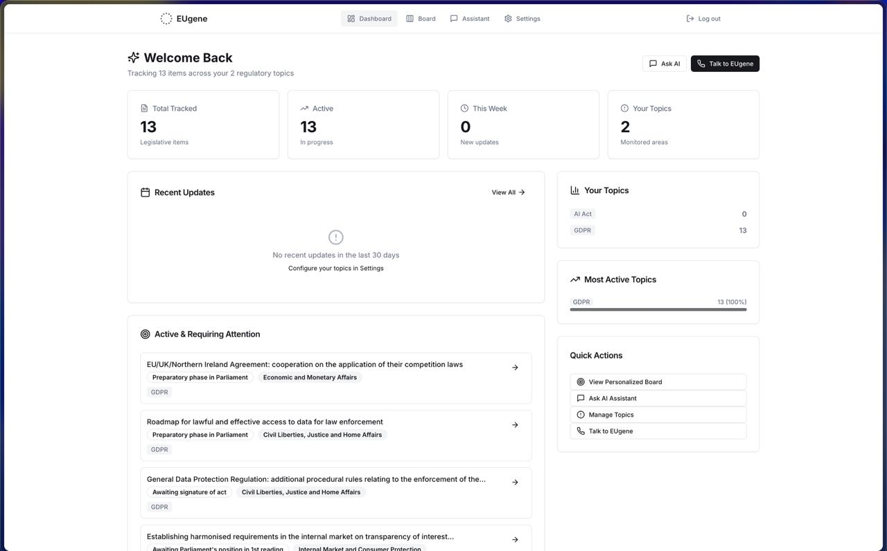
Live Demo
EUgene

Slide 7
€170B
Annual EU Spending on Compliance
€20B
Annual EU Spending on Regulatory Monitoring
€250M
Compliance pressured industries

Slide 8
If you’re building in Europe, this is your new superpower.
Let’s see EUgene in action.
Notes:
If you’re building in Europe, this is your new superpower.
Let’s see EUgene in action.

